Slide 1
Cost Benefit Evaluation techniques
Module 2_02

Slide 2
Cost Benefit Evaluation techniques
It consider
the timing of the costs and benefits
the benefits relative to the size of the investment
Common method for comparing projects on the basic of their cash flow forecasting.
1) Net profit
2) Payback Period
3) Return on investment
4) Net present Value
5) Internal rate of return

Slide 3
Net profit
Net profit
calculated by subtracting a company's total expenses from total income.
showing what the company has earned (or lost) in a given period of time (usually one year).
also called net income or net earnings.
Net profit = total costs - total incomes

Slide 4
Calculate net profit
Year | Project 1 | Project 2 | Project 3 | Project 4
0 | -100000 | -1000000 | -100000 | -120000
1 | 10000 | 200000 | 30000 | 30000
2 | 10000 | 200000 | 30000 | 30000
3 | 10000 | 200000 | 30000 | 30000
4 | 20000 | 200000 | 30000 | 30000
5 | 100000 | 300000 | 30000 | 75000
Net Profit | 50000 | 100000 | 50000 | 75000
All the values are end of year totals (Rs)
Cash flow take place at the end of each year.
The value of year 0 represents the initial investment made at the start of the project.

Slide 5
Payback Period
The payback period is the time taken to recover the initial investment.
Or
is the length of time required for cumulative incoming returns to equal the cumulative costs of an investment
Advantages
simple and easy to calculate.
It is also a seriously flawed method of evaluating investments
Disadvantages
It attaches no value to cashflows after the end of the payback period.
It makes no adjustments for risk.
It is not directly related to wealth maximisation as NPV is.
It ignores the time value of money.
The "cut off" period is arbitrary.

Slide 6
Calculate the payback period
Year | Project 1 | Project 2 | Project 3 | Project 4
0 | -100000 | -1000000 | -100000 | -120000
1 | 10000 | 200000 | 30000 | 30000
2 | 10000 | 200000 | 30000 | 30000
3 | 10000 | 200000 | 30000 | 30000
4 | 20000 | 200000 | 30000 | 30000
5 | 100000 | 300000 | 30000 | 75000
Net Profit | 50000 | 100000 | 50000 | 75000
Project1 =10,000+10,000+10,000+20,000+1,00,000=1,50,000 (5th year)
Project 2= 2,00,000+2,00,000+2,00,000+2,00,000+3,00,000=11,000,00 (5th Year)
Project 3= 30,000+30,000+30,000+30,000 + 30,000 =1,95,000 (4th year)
Project 4 = 30,000+30,000+30,000+30,000 + 75,000 =1,95,000 (4th year)
It ignores any benefits that occur after the payback period and, therefore, does not measure profitability.
It ignores the time value of money.

Slide 7
RETURN ON INVESTMENT or ACCOUNTING RATE OF RETURN
It provides a way of comparing the net profitability to the investment required.
Or
A performance measure used to evaluate the efficiency of an investment or to compare the efficiency of a number of different investments
Disadvantages
It takes no account of the timing of the cash flows.
Rate of returns bears no relationship to the interest rates offered or changed by bank.

Slide 8
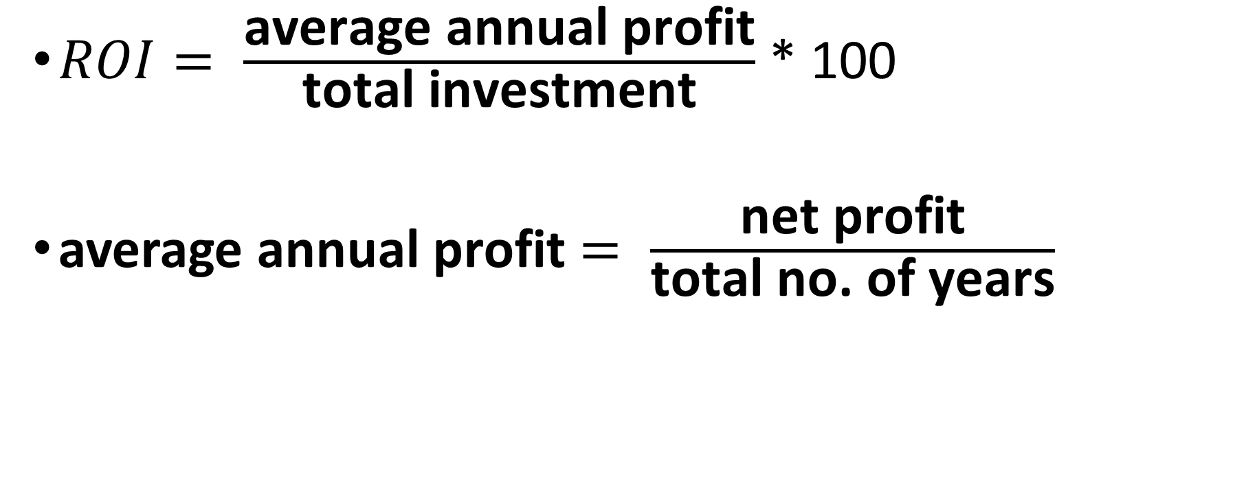
RETURN ON INVESTMENT
$ROI= \frac{\text{average} \text{annual} \text{profit}}{\text{total} \text{investment}}$ * 100
average annual profit $= \frac{\text{net} \text{profit}}{\text{total} \text{no}\text{. }\text{of} \text{years}}$

Slide 9
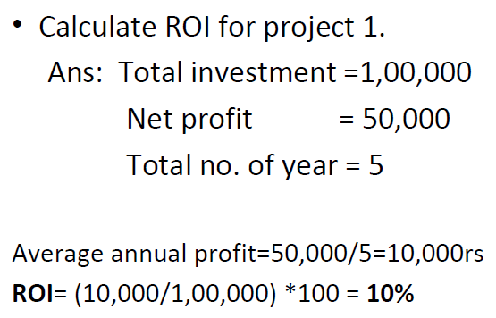
RoI Calculations

Slide 10
Net present value (NPV)
Discounted Cash Flow (DCF) is a cash flow summary adjusted to reflect the time value of money. DCF can be an important factor when evaluating or comparing investments, proposed actions, or purchases. Other things being equal, the action or investment with the larger DCF is the better decision. When discounted cash flow events in a cash flow stream are added together, the result is called the Net Present Value (NPV).
When the analysis concerns a series of cash inflows or outflows coming at different future times, the series is called a cash flow stream. Each future cash flow has its own value today (its own present value). The sum of these present values is the Net Present Value for the cash flow stream.
The size of the discounting effect depends on two things: the amount of time between now and each future payment (the number of discounting periods) and an interest rate called the Discount Rate.

Slide 11
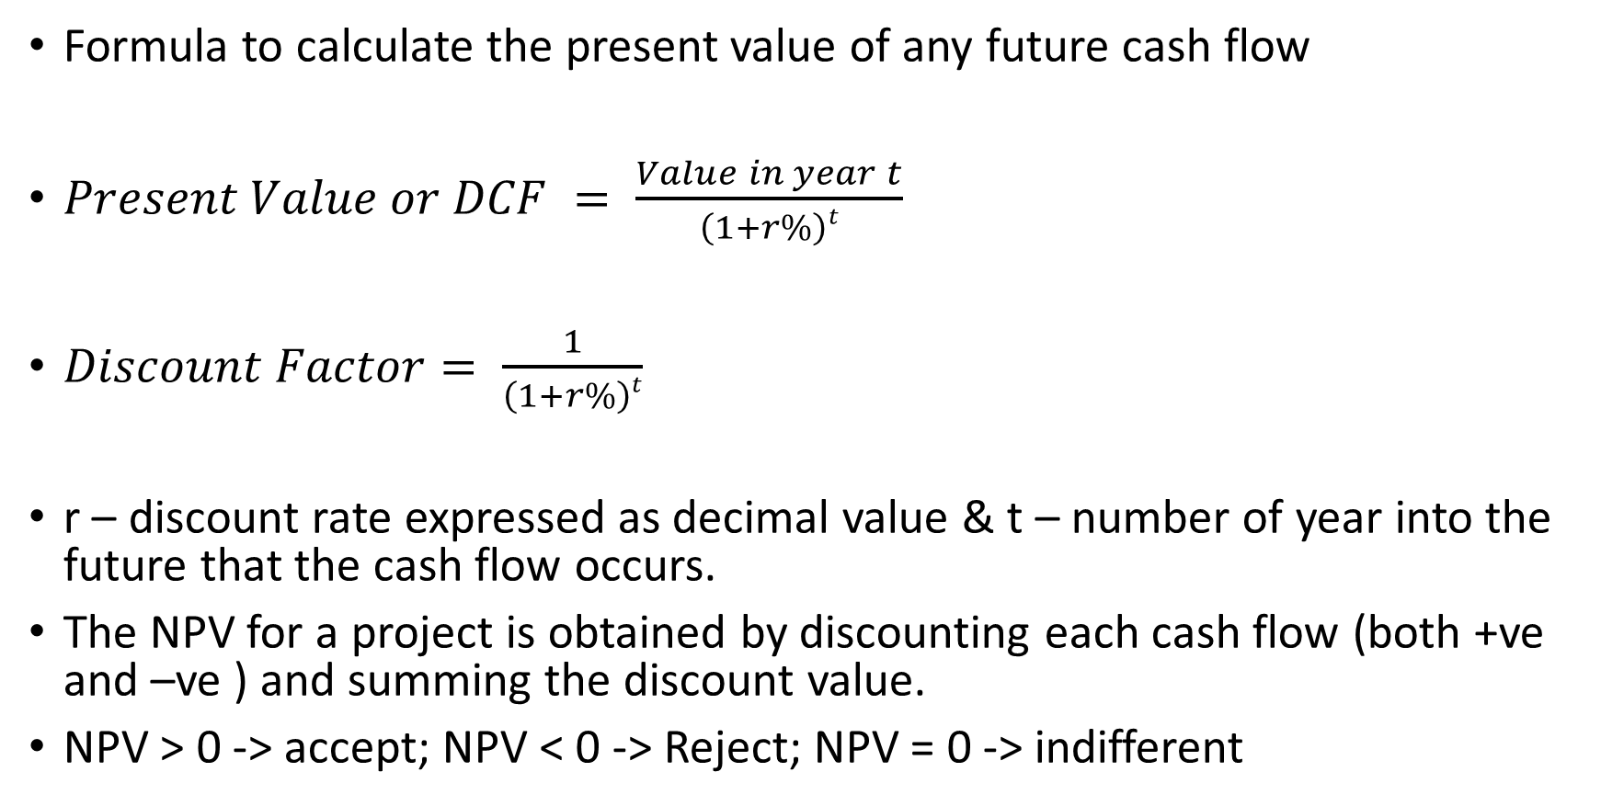
Calculation
Formula to calculate the present value of any future cash flow
$Present Value or DCF = \frac{Value in year t}{\left(1+r\%\right)t}$
$Discount Factor= \frac{1}{\left(1+r\%\right)t}$
r – discount rate expressed as decimal value & t – number of year into the future that the cash flow occurs.
The NPV for a project is obtained by discounting each cash flow (both +ve and –ve ) and summing the discount value.
NPV > 0 -> accept; NPV < 0 -> Reject; NPV = 0 -> indifferent

Slide 12
Problem
Year | Project 1
0 | -100000
1 | 10000
2 | 10000
3 | 10000
4 | 20000
5 | 100000
Assume a 10% discount rate, Calculate the NPV for the project 1.

Slide 13
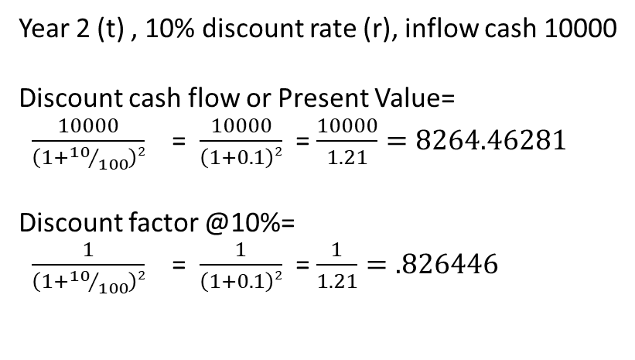
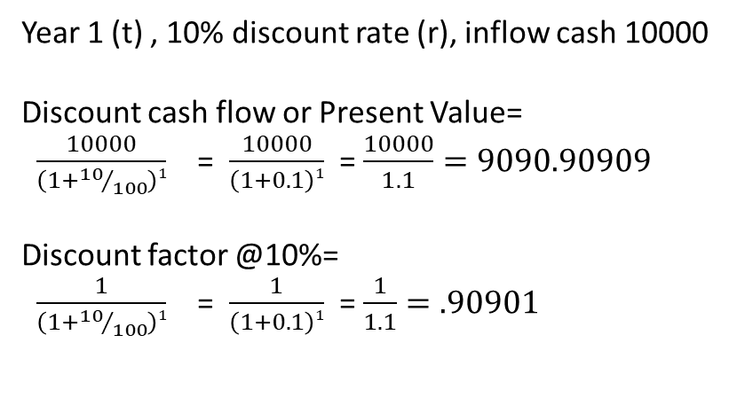
Year | Project 1 | Discount cash flow or Present Value | Discount factor @ 10%
0 | -100000 | -100000 | 1
1 | 10000 | 9090.90909 | 0.909091
2 | 10000 | 8264.46281 | 0.826446
3 | 10000 | 7513.14801 | 0.751315
4 | 20000 | 13660.2691 | 0.683013
5 | 100000 | 62092.1323 | 0.620921
SUM | 50000 | 620.921323
Net Profit | 50000
NPV | 620.92
Year 1 (t) , 10% discount rate (r), inflow cash 10000
Discount cash flow or Present Value=
$\frac{10000}{\left(1+{10}/{100}\right)1}$ = $\frac{10000}{\left(1+0.1\right)1}$ = $\frac{10000}{1.1}=9090.90909$
Discount factor @10%=
$\frac{1}{\left(1+{10}/{100}\right)1}$ = $\frac{1}{\left(1+0.1\right)1}$ = $\frac{1}{1.1}=.90901$
Year 2 (t) , 10% discount rate (r), inflow cash 10000
Discount cash flow or Present Value=
$\frac{10000}{\left(1+{10}/{100}\right)2}$ = $\frac{10000}{\left(1+0.1\right)2}$ = $\frac{10000}{1.21}=8264.46281$
Discount factor @10%=
$\frac{1}{\left(1+{10}/{100}\right)2}$ = $\frac{1}{\left(1+0.1\right)2}$ = $\frac{1}{1.21}=.826446$

Slide 14
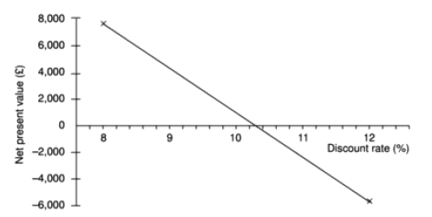
IRR (Internal Rate Return)
The IRR compares returns to costs by asking: "What is the discount rate that would give the cash flow stream a net present value of 0?“
The IRR may be estimated by plotting a series of guesses

Slide 15
Cont..
For a particular project, a discount rate of 8% gives a positive NPV of 7,896.
a discount rate of 12% gives a negative NPV of -5,829.
The IRR is therefore somewhere between these two values.
Plotting the two values on a chart and joining the points with a straight line suggests that the IRR is about 10.25%.
The true IRR is 10.167%
IRR as the decision criterion, the one with the higher IRR is the better
choice.

